Slide 1
SoC Estimation Methods
Peerapol Yuvapoositanon

Slide 2
State of Charge (SoC) Estimation Methods: Overview and Comparison
In battery management systems (BMS), State of Charge (SoC) is like a fuel gauge for batteries — it tells how much usable energy remains. However, you can't measure SoC directly, like you can measure voltage or current. Instead, we estimate it.
There are Three major classes of SoC estimation methods:

Slide 3
Why Estimate SoC?
The State of Charge (SoC) is a critical parameter in battery management systems (BMS). It represents the remaining charge in the battery as a percentage of its total capacity. Accurate SoC estimation is essential for:
Ensuring safe and efficient operation of the battery.
Preventing overcharging or deep discharging, which can damage the battery.
Providing users with accurate information about battery life.
However, directly measuring SoC is not possible because it is an internal state of the battery. Instead, SoC must be estimated using indirect measurements like:
Current : Used for Coulomb counting (Ah-Integration).
Voltage : Related to the Open-Circuit Voltage (OCV), which depends on SoC.
These measurements are often noisy and subject to inaccuracies, making robust estimation challenging.

Slide 4
Challenges in SoC Estimation
Several factors make SoC estimation difficult:
Measurement Noise :
Current sensors and voltage measurements are prone to noise and errors.
For example, voltage measurements may fluctuate due to temperature, internal resistance, or transient effects.
Model Uncertainty :
Battery models (e.g., OCV vs. SoC relationships) are approximations and may not perfectly represent real-world behavior.
Factors like aging, temperature, and hysteresis further complicate the model.

Slide 5
Drift in Coulomb Counting :
Coulomb counting estimates SoC by integrating current over time. However, small errors in current measurements accumulate over time, leading to drift.
Dynamic Behavior :
Batteries are dynamic systems where SoC changes continuously based on load conditions, making real-time estimation critical.

Slide 6
Category | Main Methods | Example Techniques
Direct Measurement | Voltage-based | Open Circuit Voltage (OCV)
Coulomb Counting | Current integration | Ampere-hour counting
Model-Based Estimation | Equivalent Circuit Models (ECM) | Kalman Filters (KF, EKF, UKF)
Adaptive / Observer-based* | Online correction during operation | Luenberger Observer, Sliding Mode Observer
Data-Driven / AI-based* | Machine Learning | Neural Networks (NN), Support Vector Machines (SVM)

Slide 7
1) Direct Measurement Methods (OCV Method)
Example: Open Circuit Voltage (OCV)
Idea: SoC correlates to battery voltage when the battery is at rest (no current flowing).
Pros:
Very simple.
No complex modeling required.
Cons:
Only accurate when the battery is at rest for a long period (several hours sometimes).
Not usable during active operation (driving an EV, for example).

Slide 8







OCV Method
$$SoC_{V} =S_{0}+(S_{1}−S_{0})\frac{V−V_{0}}{V_{1}−V_{0}}$$
SoC
$$S_{1}$$
$$SoC_{V}$$
$$S_{0}$$
$$V_{0}$$
$$V$$
OCV
$$V_{1}$$

Slide 9
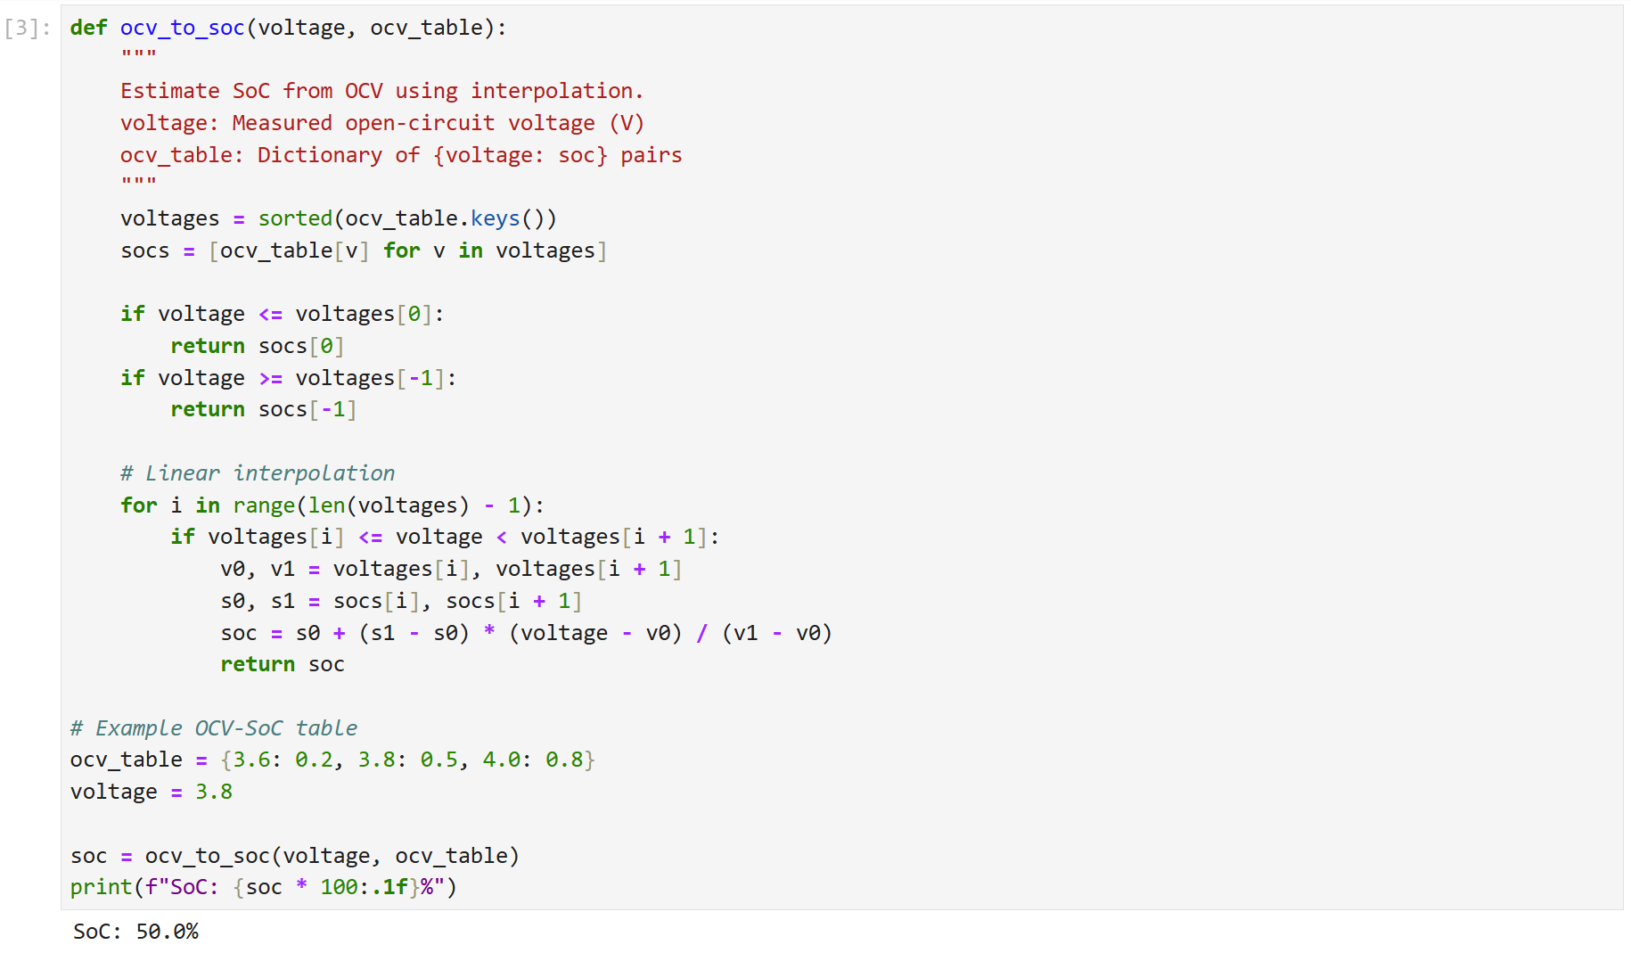
OCV Method
https://github.com/DrHammerhead/SoC-estimation/blob/main/SOC_Ah_OCV_30april25.ipynb

Slide 10
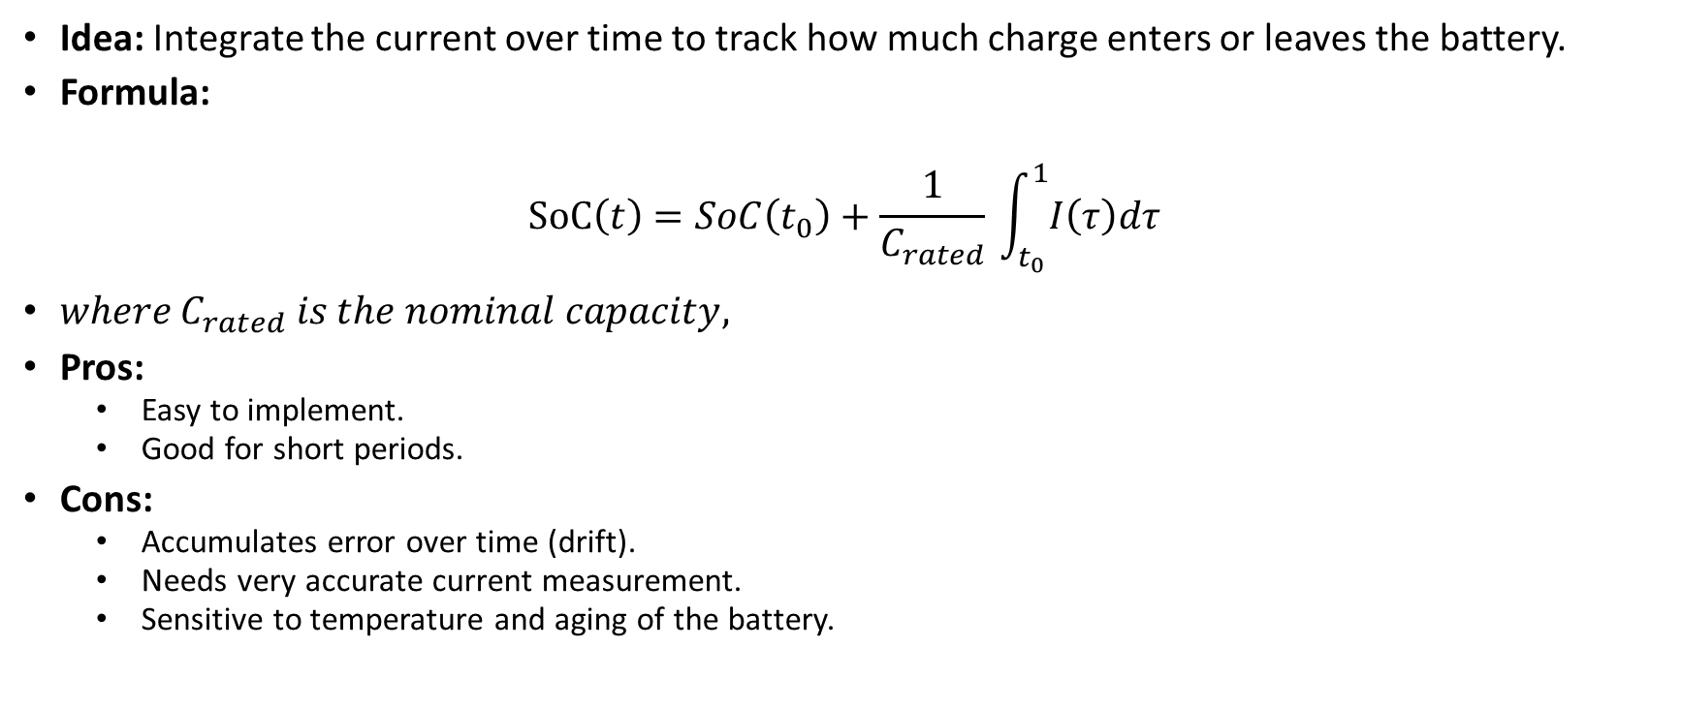
2) Coulomb Counting (Ah-Integration)
Idea: Integrate the current over time to track how much charge enters or leaves the battery.
Formula:
$$SoC\left(t\right)=SoC\left(t_{0}​\right)+\frac{1}{C_{rated}}​\int_{t_{0}}^{1}{​I\left(τ\right)dτ}$$
$where C_{rated}​ is the nominal capacity,$
Pros:
Easy to implement.
Good for short periods.
Cons:
Accumulates error over time (drift).
Needs very accurate current measurement.
Sensitive to temperature and aging of the battery.

Slide 11
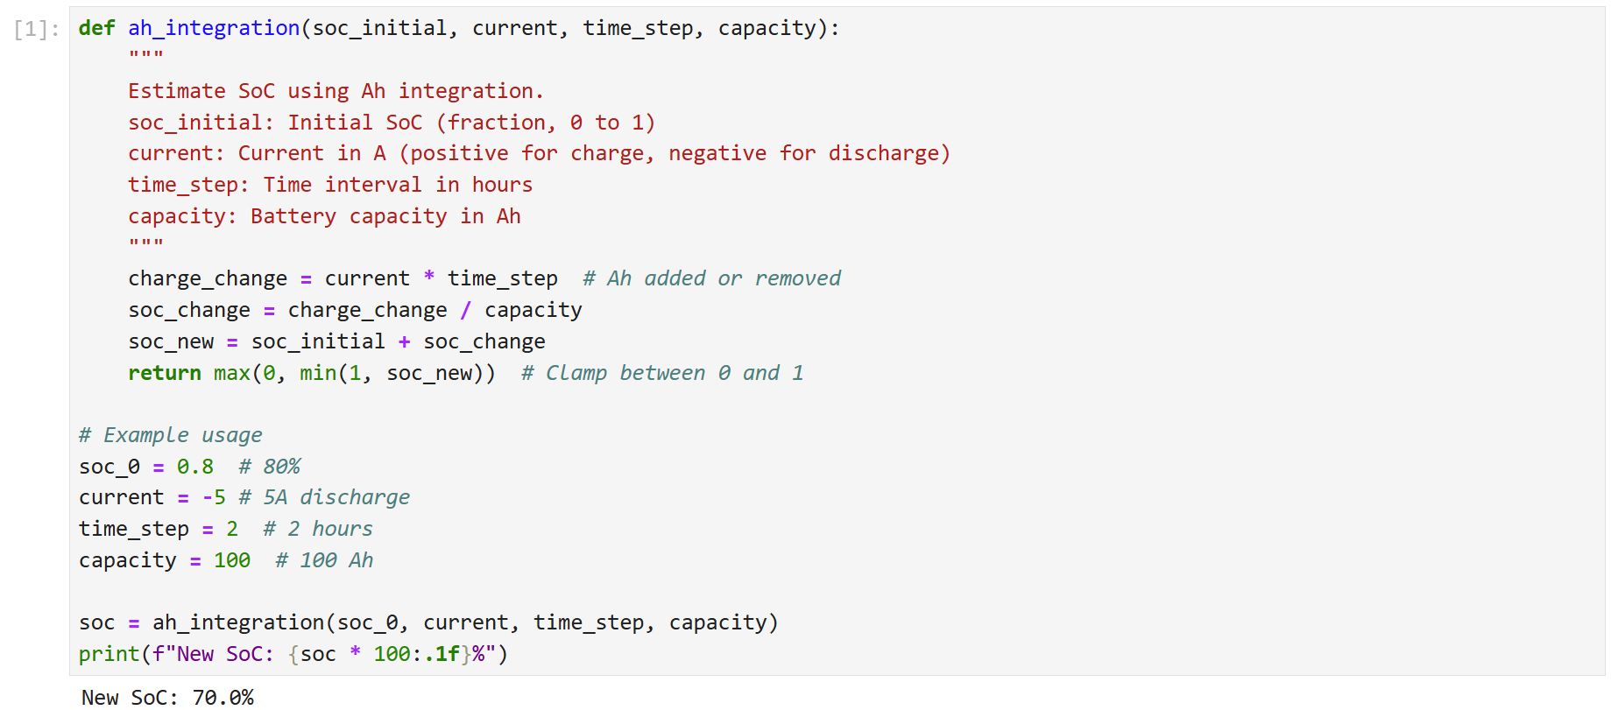
Ah Integration Method
https://github.com/DrHammerhead/SoC-estimation/blob/main/SOC_Ah_OCV_30april25.ipynb

Slide 12
3) Model-Based Estimation (Kalman Filters)
Idea: Model the battery using electrical equivalents (resistors, capacitors) and apply estimation techniques.
Popular Tools:
Extended Kalman Filter (EKF)
Unscented Kalman Filter (UKF)
Pros:
Good balance between accuracy and real-time performance.
Can correct for some noise and errors.
Cons:
Requires good battery models.
More complex to implement.
Computationally heavier than simple counting.

Slide 13
Why Use a Kalman Filter?
The Kalman Filter is an ideal tool for SoC estimation because it addresses the above challenges effectively:
Combines Predictions and Measurements :
The Kalman Filter uses Coulomb counting (current integration) to predict SoC and then refines the prediction using voltage measurements .
This combination reduces reliance on either method alone, improving accuracy.
Handles Noise :
The filter accounts for uncertainties in both the prediction (process noise) and measurements (measurement noise).
By weighting predictions and measurements based on their respective uncertainties, the Kalman Filter minimizes the impact of noise.

Slide 14
Recursive and Real-Time :
The Kalman Filter operates recursively, updating the SoC estimate at each time step. This makes it suitable for real-time applications like BMS.
Optimal Estimation :
Under the assumptions of linearity and Gaussian noise, the Kalman Filter provides the minimum mean square error (MMSE) estimate of the state.

Slide 15
The Extended Kalman Filter (EKF) is a powerful extension of the standard Kalman Filter that allows it to handle nonlinear systems.
In a nonlinear system, the state transition and measurement models are expressed as:

Slide 16
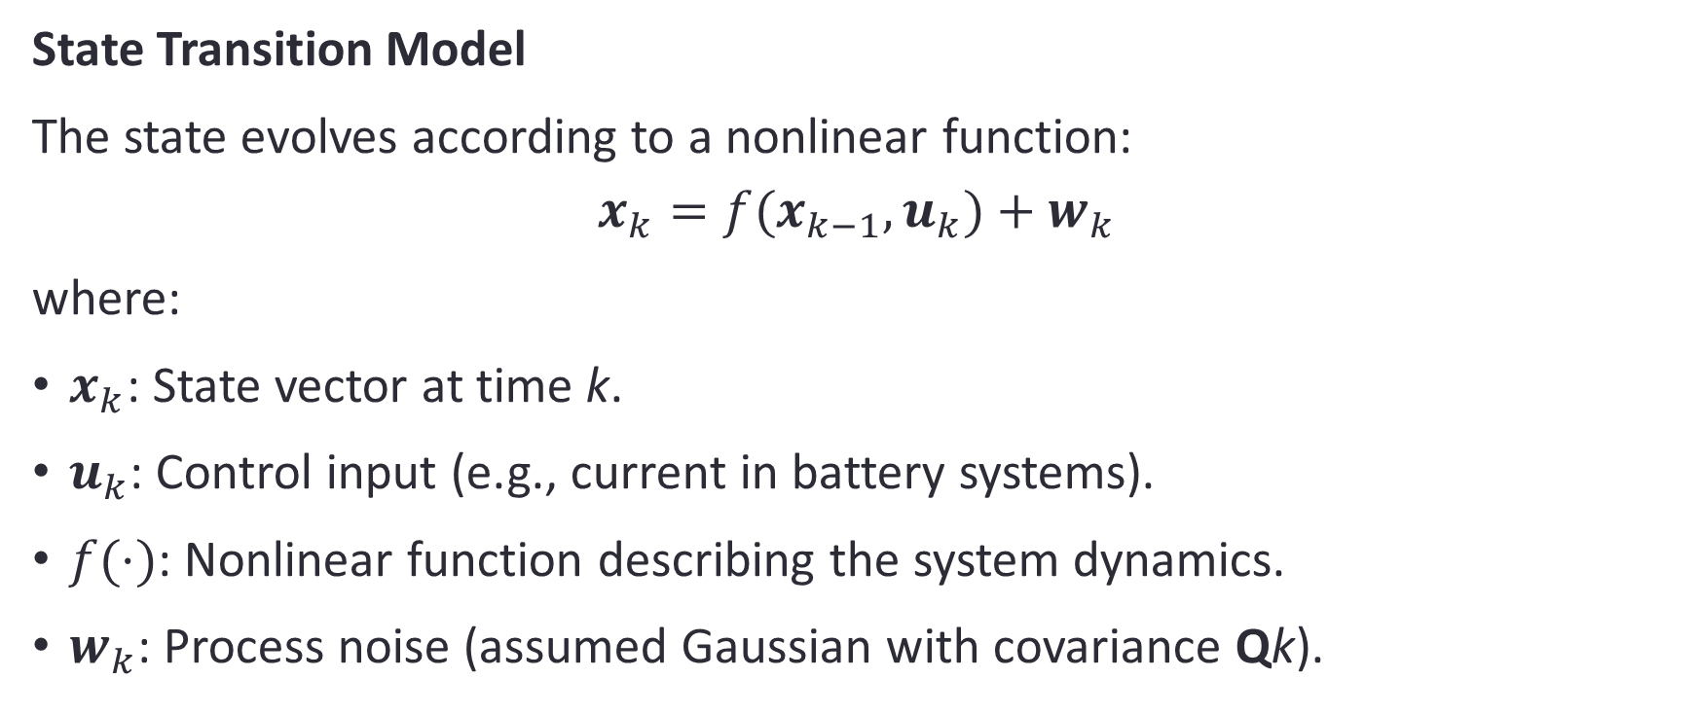
Problem Setup
State Transition Model
The state evolves according to a nonlinear function:
$$x_{k}​=f(x_{k−1}​,u_{k}​)+w_{k}​$$
where:
$x_{k}​$: State vector at time k.
$u_{k}​$: Control input (e.g., current in battery systems).
$f(⋅)$: Nonlinear function describing the system dynamics.
$w_{k}​$: Process noise (assumed Gaussian with covariance Qk​).

Slide 17
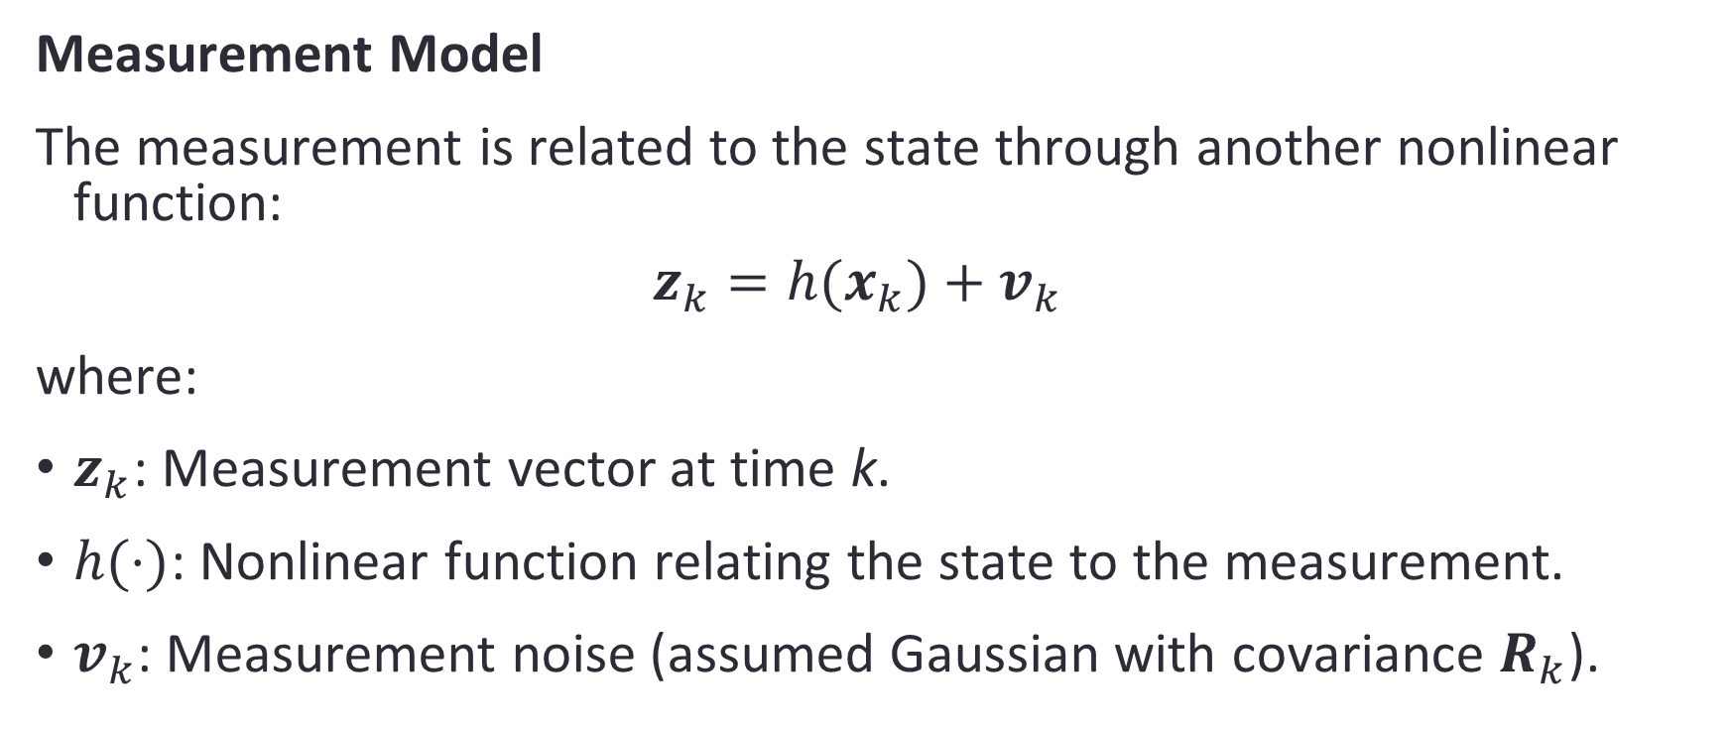
Measurement Model
The measurement is related to the state through another nonlinear function:
$$z_{k}​=h(x_{k}​)+v_{k}​$$
where:
$z_{k}$​: Measurement vector at time k.
$h(⋅)$: Nonlinear function relating the state to the measurement.
$v_{k}​$: Measurement noise (assumed Gaussian with covariance $R_{k}​$).

Slide 18
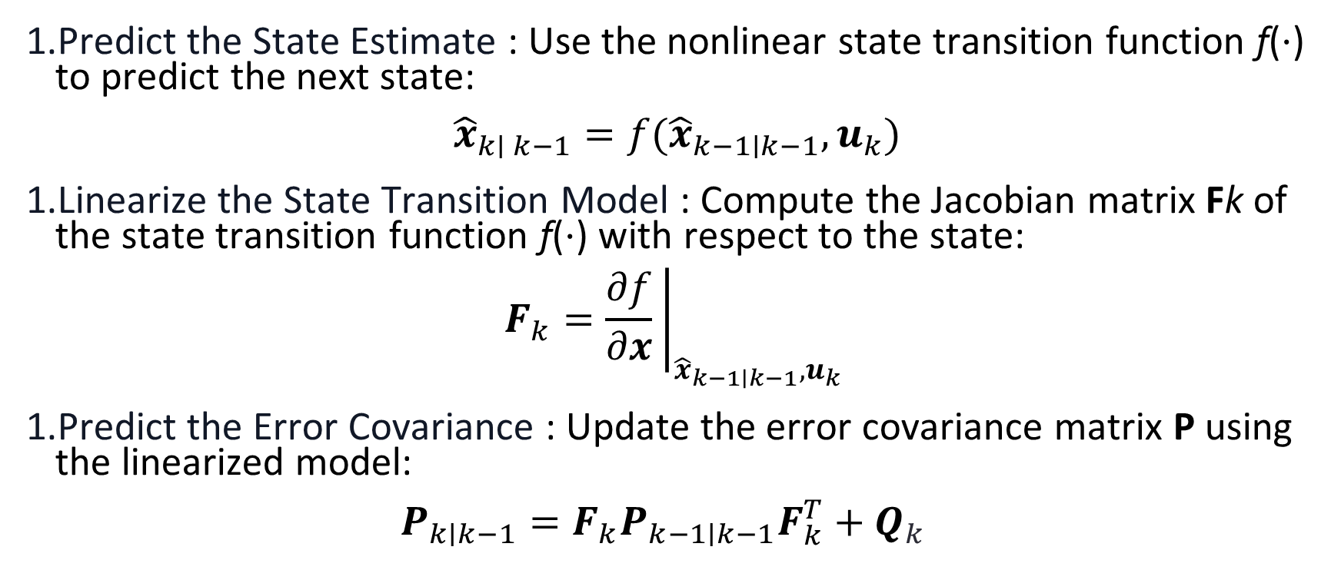
Step 1: Prediction
Predict the State Estimate : Use the nonlinear state transition function f(⋅) to predict the next state:
$${\hat{x}}_{k∣ k−1}​=f({\hat{x}}_{k−1∣k−1}​,u_{k}​)$$
Linearize the State Transition Model : Compute the Jacobian matrix Fk​ of the state transition function f(⋅) with respect to the state:
$$F_{k}​={\left.\frac{∂f}{∂x}​\right|}_{{\hat{x}}_{k−1∣k−1​},u_{k}}​​​$$
Predict the Error Covariance : Update the error covariance matrix P using the linearized model:
$$P_{k∣k−1}​=F_{k}​P_{k−1∣k−1}​F_{k}^{T}​+Q_{k}​$$

Slide 19
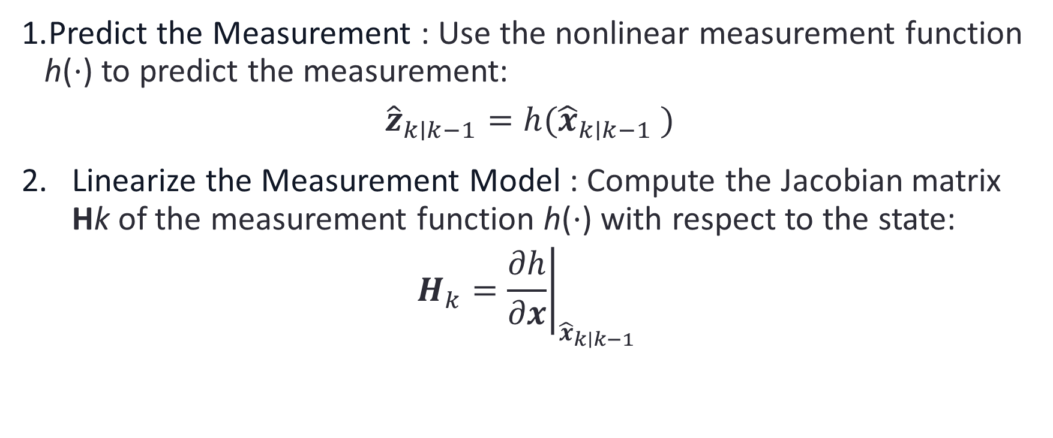
Step 2: Update
Predict the Measurement : Use the nonlinear measurement function h(⋅) to predict the measurement:
$${\hat{z}}_{k∣k−1}​=h({\hat{x}}_{k∣k−1} ​)$$
Linearize the Measurement Model : Compute the Jacobian matrix Hk​ of the measurement function h(⋅) with respect to the state:
$$H_{k}​={\left.\frac{∂h}{∂x}\right|}_{{\hat{x}}_{k∣k−1}​​}​​$$

Slide 20
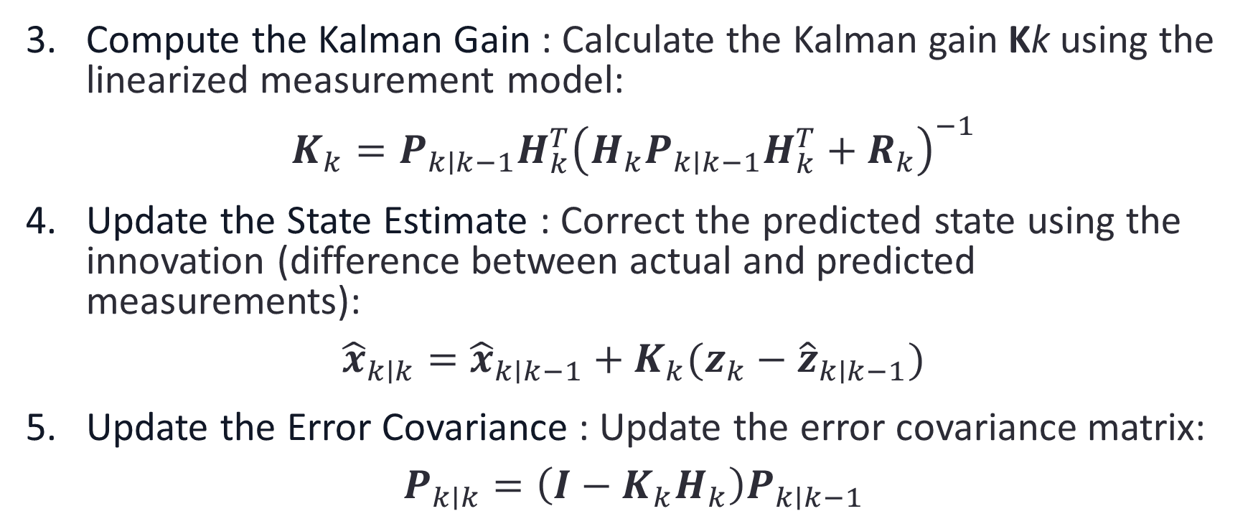
Compute the Kalman Gain : Calculate the Kalman gain Kk​ using the linearized measurement model:
$$K_{k}​=P_{k∣k−1}​H_{k}^{T}​{\left(H_{k}​P_{k∣k−1}​H_{k}^{T}​+R_{k​}\right)}^{−1}$$
Update the State Estimate : Correct the predicted state using the innovation (difference between actual and predicted measurements):
$${\hat{x}}_{k∣k}​={\hat{x}}_{k∣k−1}​+K_{k}​(z_{k}​−{\hat{z}}_{k∣k−1}​)$$
Update the Error Covariance : Update the error covariance matrix:
$$P_{k∣k}​=\left(I−K_{k}​H_{k}​\right)P_{k∣k−1}​$$

Slide 21
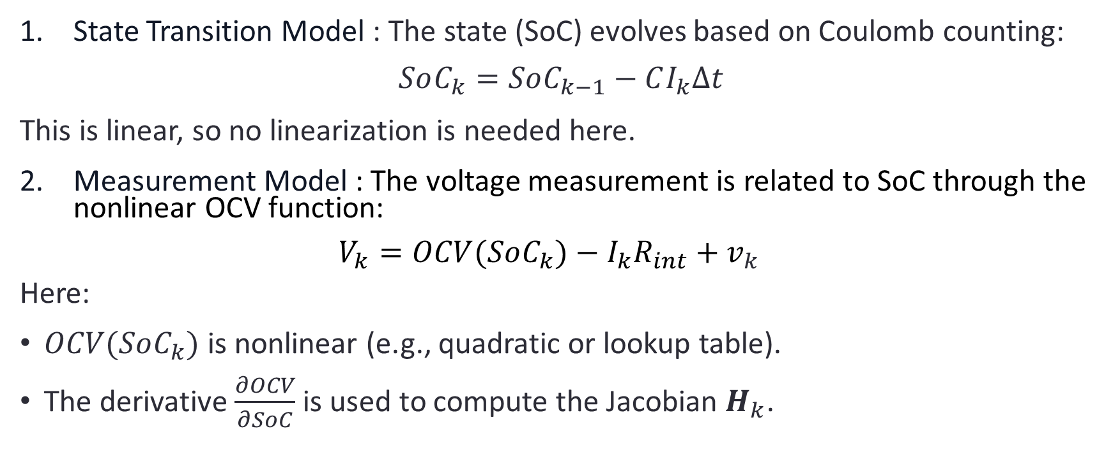
Application to Battery SoC Estimation
State Transition Model : The state (SoC) evolves based on Coulomb counting:
$$SoC_{k}​=SoC_{k−1}​−CI_{k}​Δt​$$
This is linear, so no linearization is needed here.
Measurement Model : The voltage measurement is related to SoC through the nonlinear OCV function:
$$V_{k}​=OCV(SoC_{k}​)−I_{k}​R_{int}​+v_{k}​$$
Here:
$OCV(SoC_{k}​)$is nonlinear (e.g., quadratic or lookup table).
The derivative $\frac{∂OCV}{∂SoC}$is used to compute the Jacobian $H_{k}​$.

Slide 22
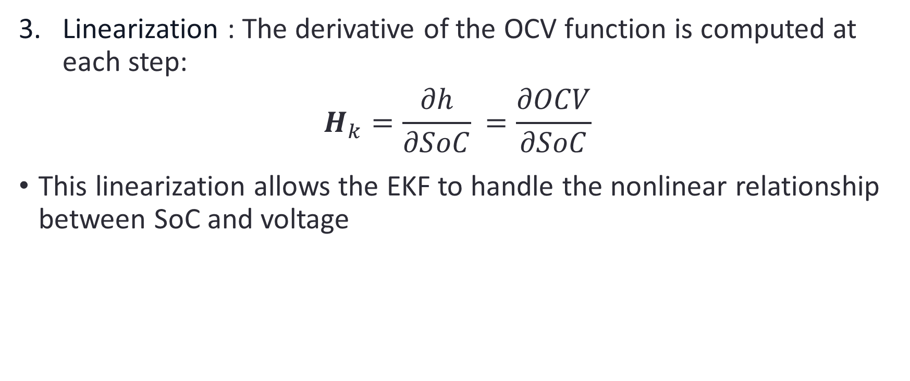
Linearization : The derivative of the OCV function is computed at each step:
$$H_{k}​=\frac{∂h}{∂SoC}​=\frac{∂OCV}{∂SoC}​$$
This linearization allows the EKF to handle the nonlinear relationship between SoC and voltage

Slide 23
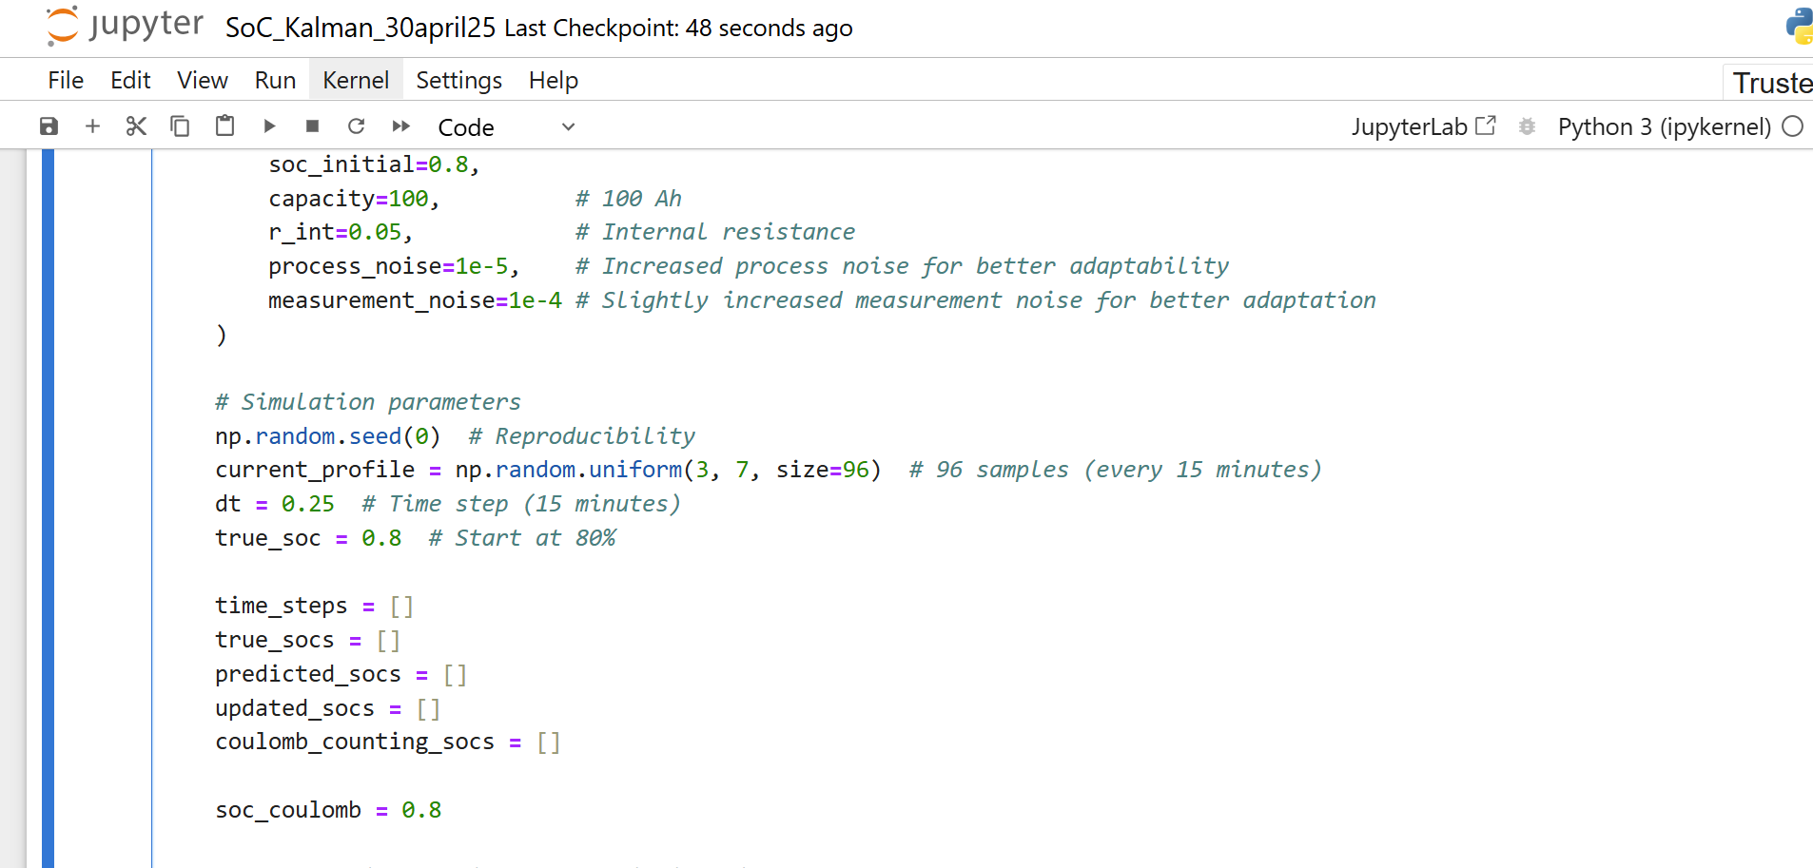
SoC_Kalman_30april25.ipynb
https://github.com/DrHammerhead/SoC-estimation/blob/main/SoC_Kalman_30april25.ipynb

Slide 24


Slide 25
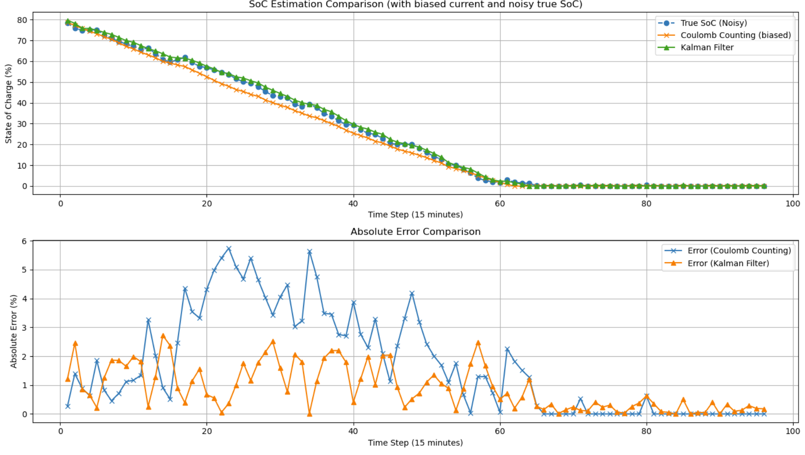

Slide 26
How Temperature Affects Coulomb Counting
a. Battery Capacity Is Temperature-Dependent
Battery capacity CCC decreases at low temperatures because:
Electrochemical reactions slow down
Internal resistance increases
Some capacity becomes inaccessible
Example:
A 100Ah battery might only deliver ~80Ah at -10°C.
➡️ Coulomb counting will overestimate SoC at low temps, since it assumes a fixed 100Ah.
b. Current Sensor Drift
Shunt-based or Hall-effect current sensors can drift with temperature, leading to:
Small, systematic errors in current
Which accumulate into significant SoC errors over time

Slide 27
➡️ Thermal compensation is often needed in sensor electronics.
c. Self-Discharge and Parasitic Losses
These increase with temperature:
Coulomb counting doesn't track self-discharge
High temperatures make this worse
➡️ Coulomb counting underestimates SoC at high temps if not corrected.
d. Internal Resistance & Peukert Effect
Though less significant for simple Coulomb counting:
Resistance increases at low T
High internal resistance causes greater power loss

Slide 28
Temperature Effects
Temperature | Capacity Impact | Coulomb Counting Error
Cold (< 10°C) | ↓↓ capacity | Overestimates SoC
Hot (> 35°C) | Minor ↓ capacity; ↑ self-discharge | Underestimates SoC (slowly)

Slide 29
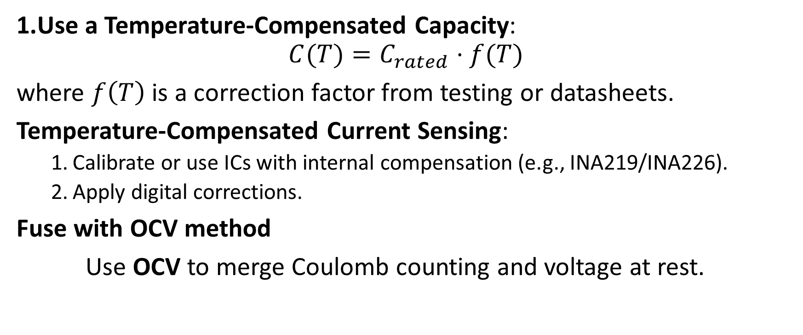
How to Improve Accuracy
Use a Temperature-Compensated Capacity:
$$C(T)=C_{rated}⋅f(T)$$
where $f\left(T\right)$ is a correction factor from testing or datasheets.
Temperature-Compensated Current Sensing:
Calibrate or use ICs with internal compensation (e.g., INA219/INA226).
Apply digital corrections.
Fuse with OCV method
Use OCV to merge Coulomb counting and voltage at rest.

Slide 30
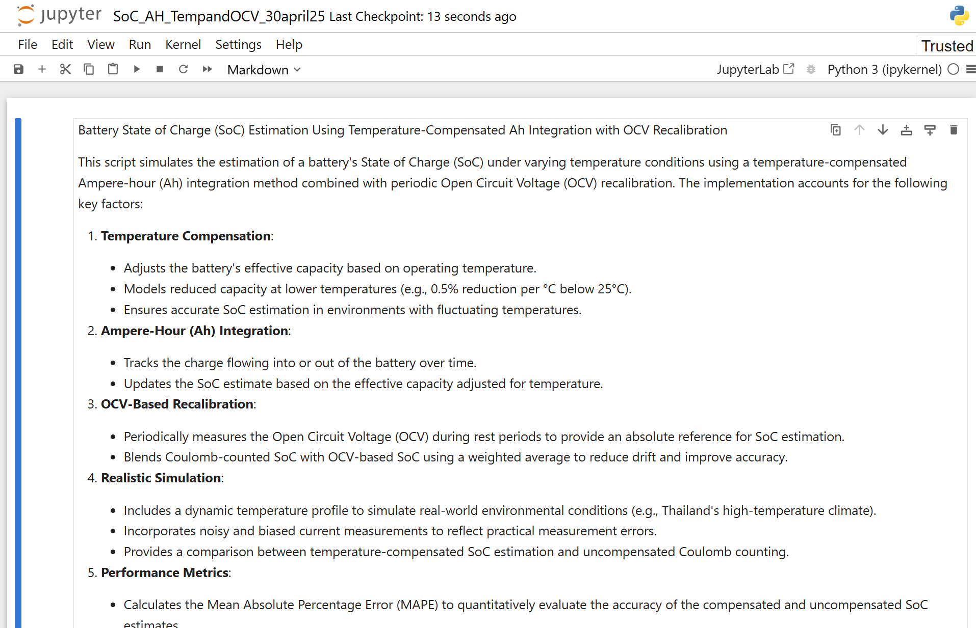
SoC_AH_TempandOCV_30april25.ipynb
https://github.com/DrHammerhead/SoC-estimation/blob/main/SoC_AH_TempandOCV_30april25.ipynb

Slide 31
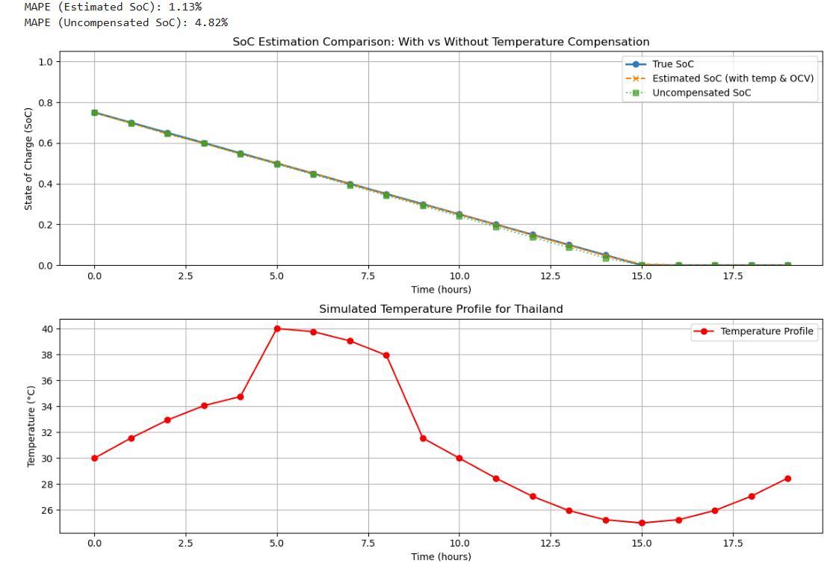

Slide 32
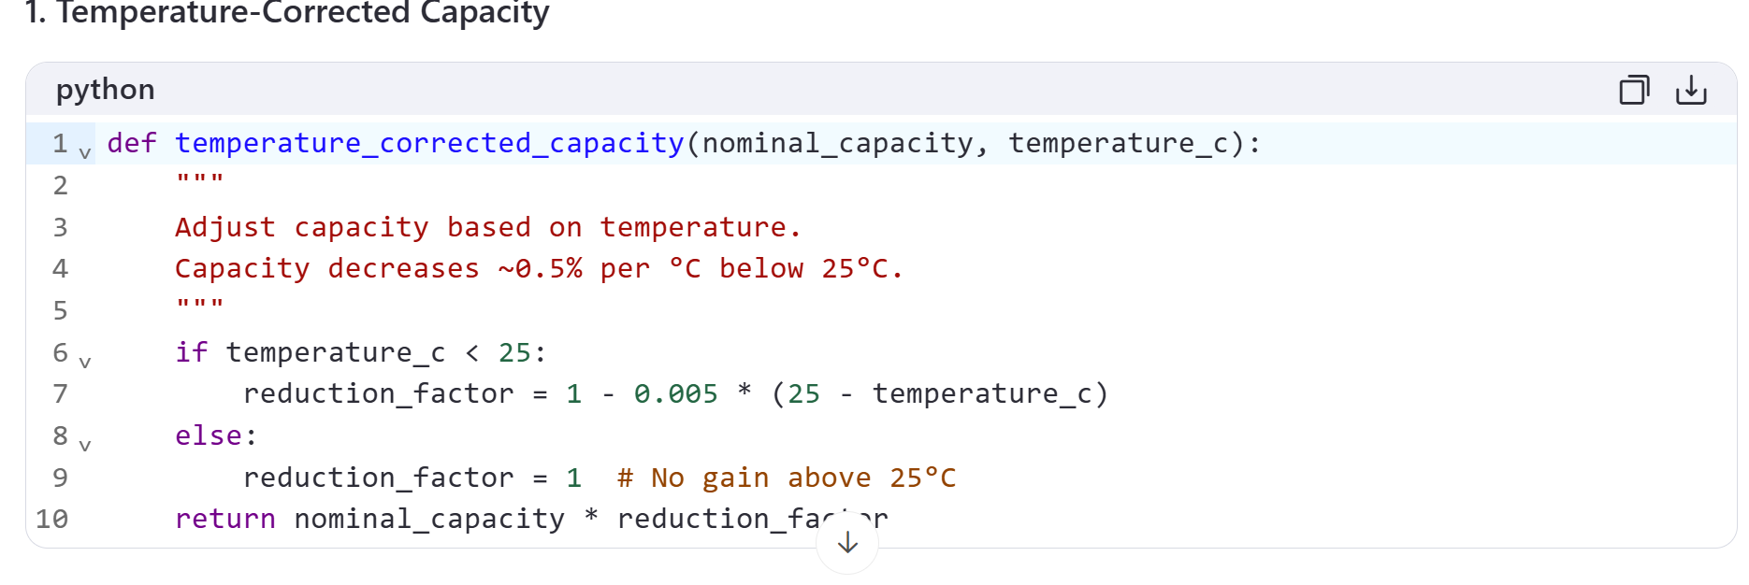
Explanation of SoC_AH_TempandOCV_30april25.ipynb

Slide 33
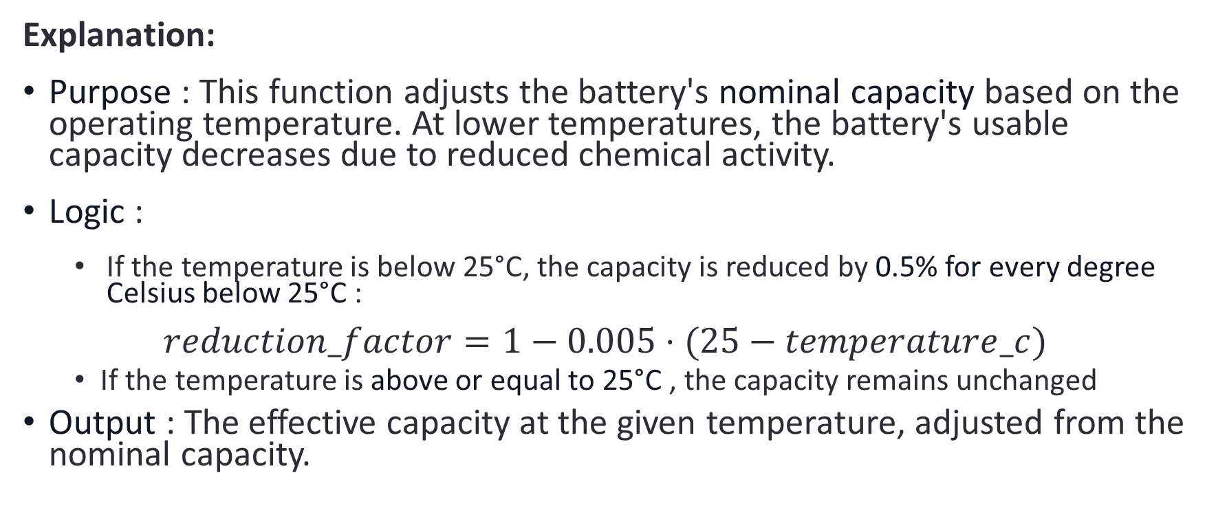
Explanation:
Purpose : This function adjusts the battery's nominal capacity based on the operating temperature. At lower temperatures, the battery's usable capacity decreases due to reduced chemical activity.
Logic :
If the temperature is below 25°C, the capacity is reduced by 0.5% for every degree Celsius below 25°C :
$$reduction_factor=1−0.005⋅(25−temperature_c)$$
If the temperature is above or equal to 25°C , the capacity remains unchanged
Output : The effective capacity at the given temperature, adjusted from the nominal capacity.

Slide 34
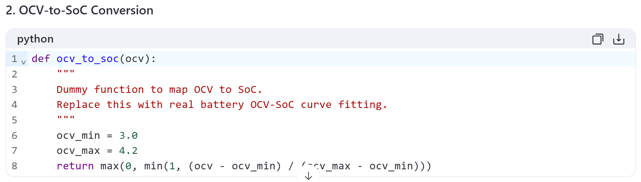

Slide 35
Explanation:
Purpose : This function converts the measured Open Circuit Voltage (OCV) into an estimated State of Charge (SoC). In real-world applications, this relationship is nonlinear and specific to the battery chemistry.
Logic :
A dummy linear mapping is used here for simplicity:
ocv_min = 3.0 V: The minimum voltage corresponding to 0% SoC.
ocv_max = 4.2 V: The maximum voltage corresponding to 100% SoC.

Slide 36
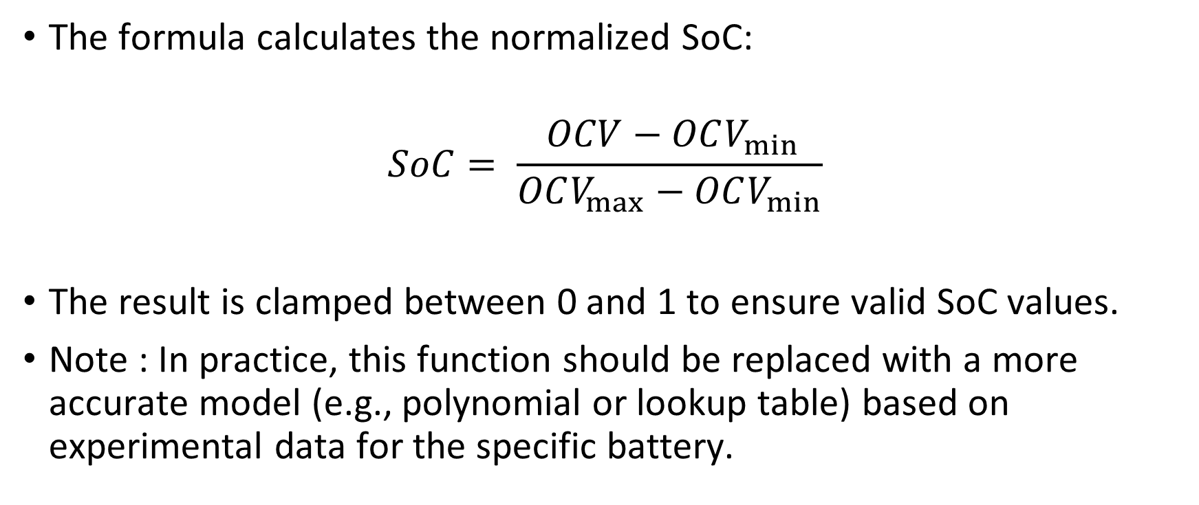
The formula calculates the normalized SoC:
$$SoC= \frac{⁡OCV−OCV_{min}}{OCV_{max}−OCV_{min}}$$
The result is clamped between 0 and 1 to ensure valid SoC values.
Note : In practice, this function should be replaced with a more accurate model (e.g., polynomial or lookup table) based on experimental data for the specific battery.

Slide 37
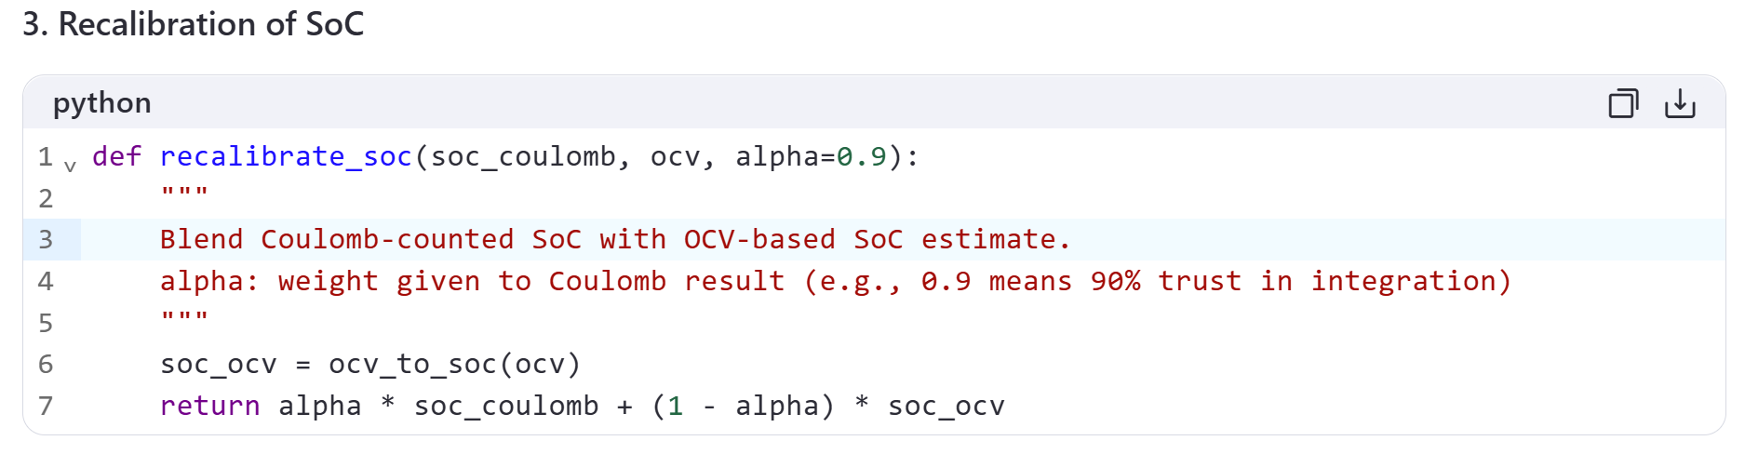

Slide 38
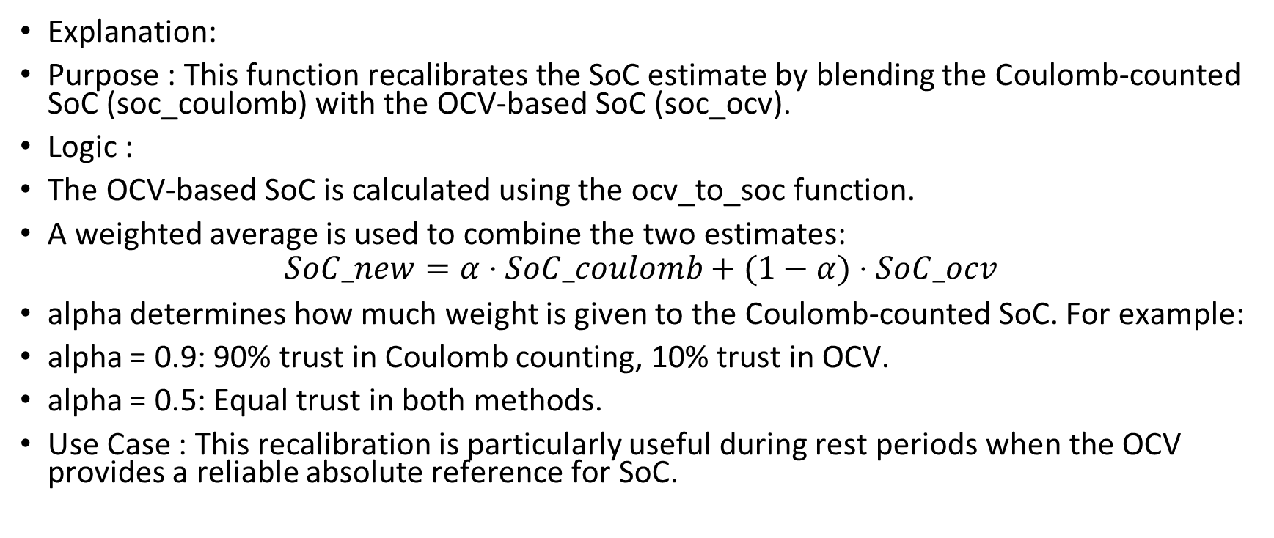
Explanation:
Purpose : This function recalibrates the SoC estimate by blending the Coulomb-counted SoC (soc_coulomb) with the OCV-based SoC (soc_ocv).
Logic :
The OCV-based SoC is calculated using the ocv_to_soc function.
A weighted average is used to combine the two estimates:
$$SoC_new=α⋅SoC_coulomb+(1−α)⋅SoC_ocv$$
alpha determines how much weight is given to the Coulomb-counted SoC. For example:
alpha = 0.9: 90% trust in Coulomb counting, 10% trust in OCV.
alpha = 0.5: Equal trust in both methods.
Use Case : This recalibration is particularly useful during rest periods when the OCV provides a reliable absolute reference for SoC.

Slide 39
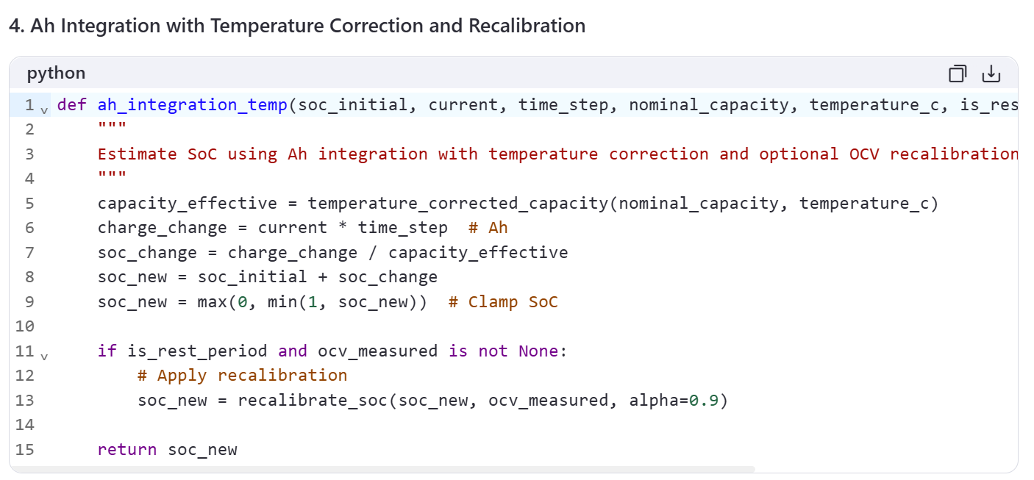

Slide 40
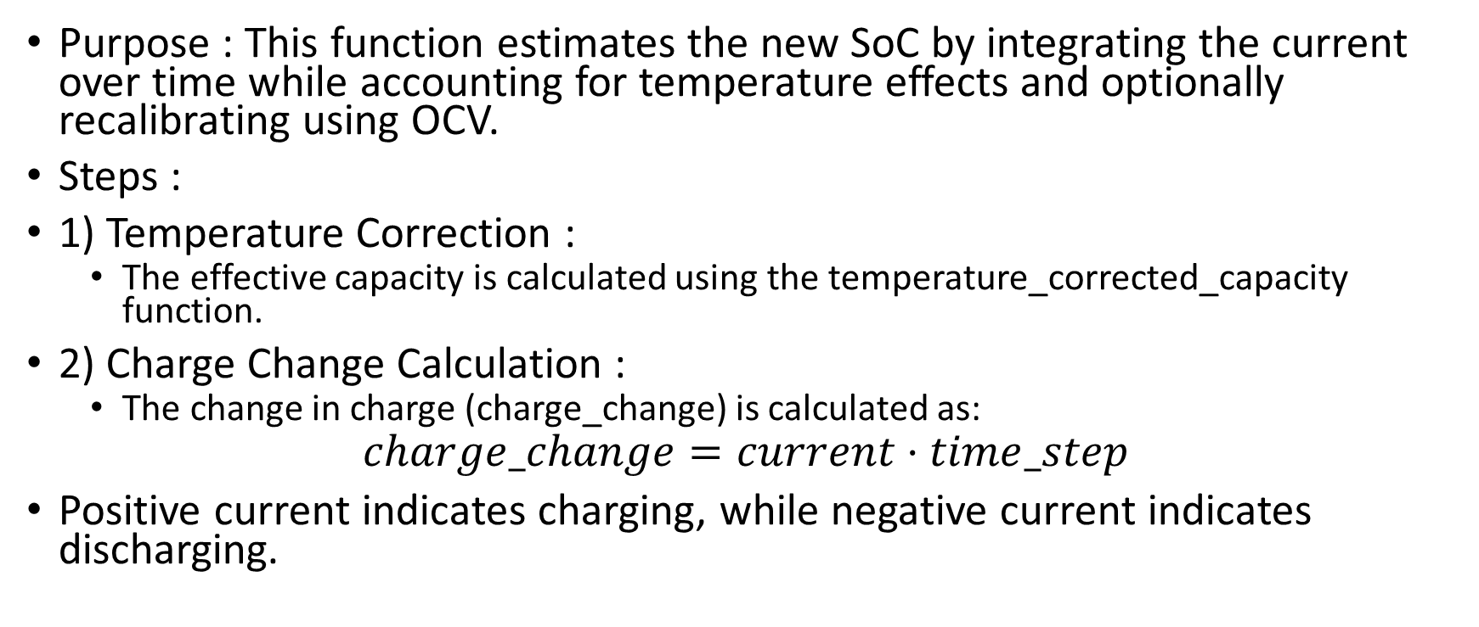
Explanation:
Purpose : This function estimates the new SoC by integrating the current over time while accounting for temperature effects and optionally recalibrating using OCV.
Steps :
1) Temperature Correction :
The effective capacity is calculated using the temperature_corrected_capacity function.
2) Charge Change Calculation :
The change in charge (charge_change) is calculated as:
$$charge_change=current⋅time_step$$
Positive current indicates charging, while negative current indicates discharging.

Slide 41
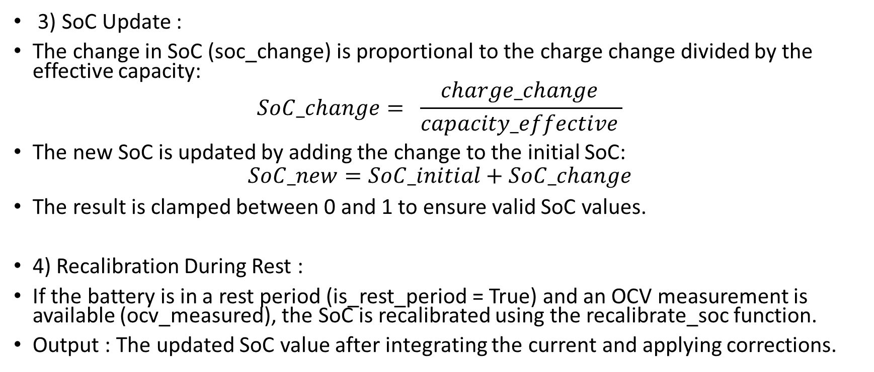
3) SoC Update :
The change in SoC (soc_change) is proportional to the charge change divided by the effective capacity:
$$SoC_change= \frac{charge_change }{capacity_effective }$$
The new SoC is updated by adding the change to the initial SoC:
$$SoC_new=SoC_initial+SoC_change$$
The result is clamped between 0 and 1 to ensure valid SoC values.
4) Recalibration During Rest :
If the battery is in a rest period (is_rest_period = True) and an OCV measurement is available (ocv_measured), the SoC is recalibrated using the recalibrate_soc function.
Output : The updated SoC value after integrating the current and applying corrections.

Slide 42
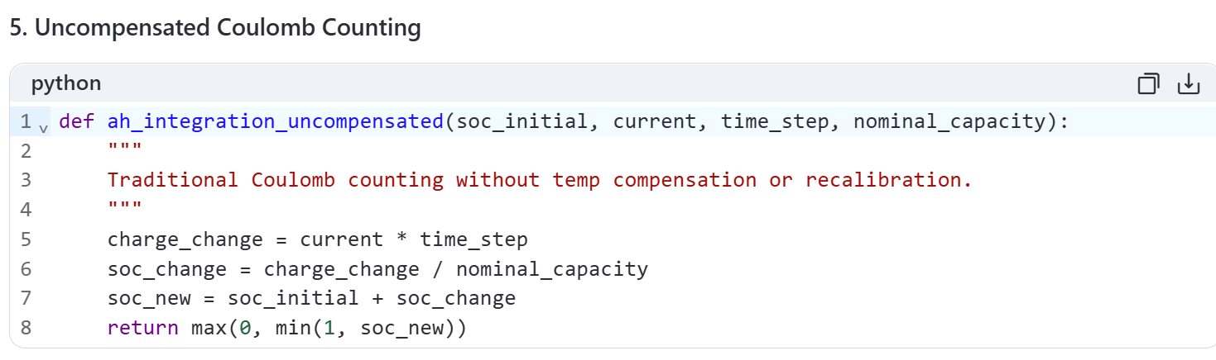

Slide 43
Explanation:
Purpose : This function performs traditional Coulomb counting without accounting for temperature effects or OCV recalibration.
Logic :
The change in SoC is calculated using the nominal capacity instead of the temperature-corrected capacity.
No recalibration is applied during rest periods.
Use Case : This serves as a baseline for comparison with the compensated method.

Slide 44
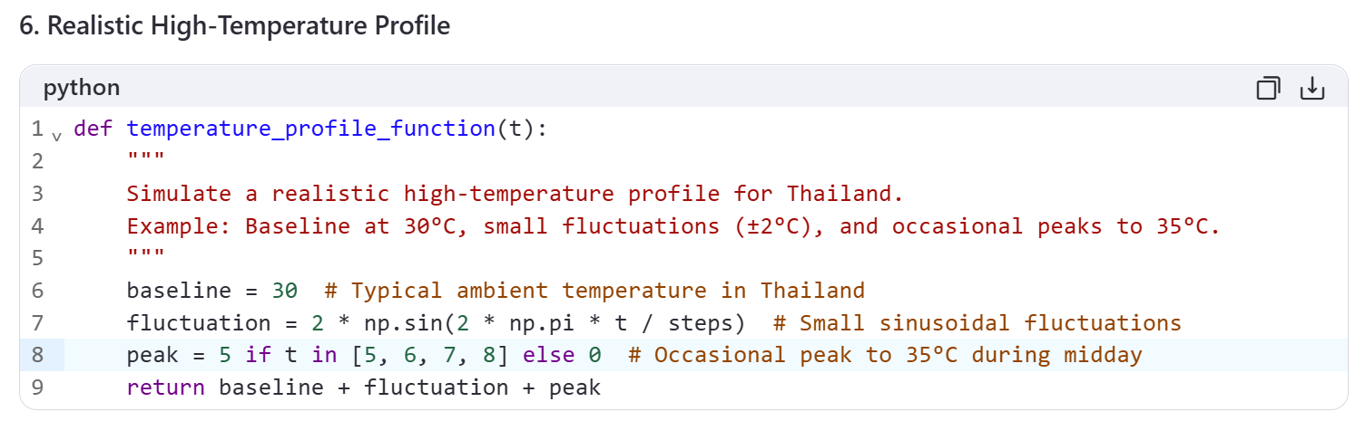

Slide 45
Explanation:
Purpose : This function simulates a realistic temperature profile for Thailand, where temperatures are consistently high with minor fluctuations and occasional peaks.
Logic :
Baseline : Starts at 30°C , representing the typical ambient temperature in Thailand.
Fluctuations : Adds small sinusoidal variations (±2°C) to simulate minor temperature changes throughout the day.
Peaks : Introduces a 5°C increase during steps 5–8 to simulate the hottest part of the day.
This profile reflects the warm and relatively stable climate of Thailand.

Slide 46
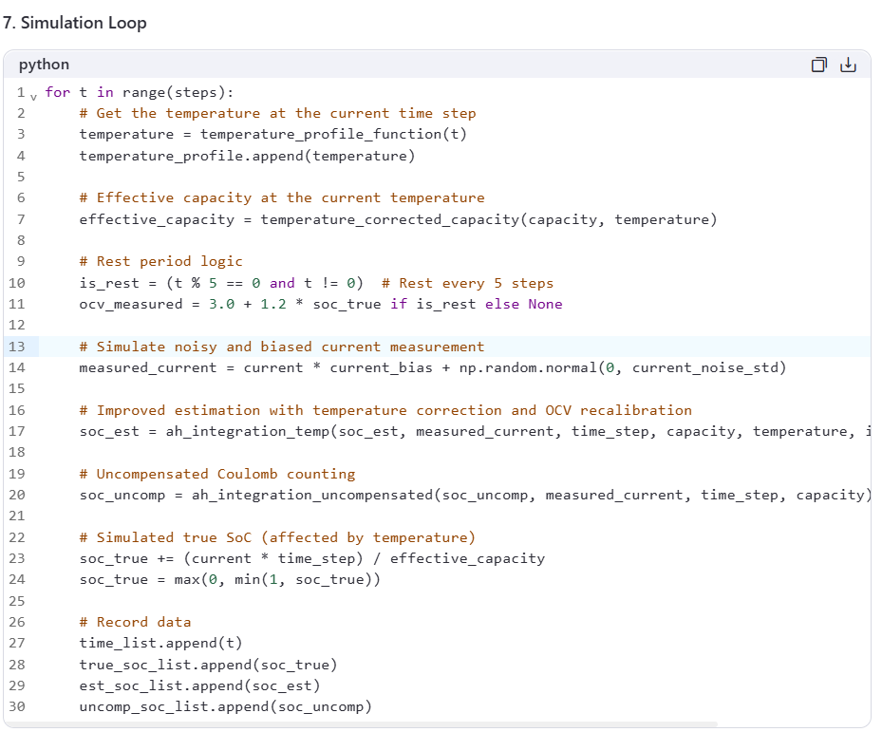

Slide 47
Explanation:
Temperature Update :
The temperature at each time step is determined using the temperature_profile_function.
Effective Capacity :
The effective capacity is recalculated based on the current temperature.
Rest Periods :
Every 5th step, the battery enters a rest period (is_rest = True), during which the OCV is measured and used for recalibration.
Noisy and Biased Current Measurement :
The measured current includes a 2% bias and random noise to simulate real-world inaccuracies.
True SoC Update :
The true SoC is updated based on the effective capacity at the simulated temperature.
Record Data :
The true, estimated, and uncompensated SoC values are recorded for plotting

Slide 48
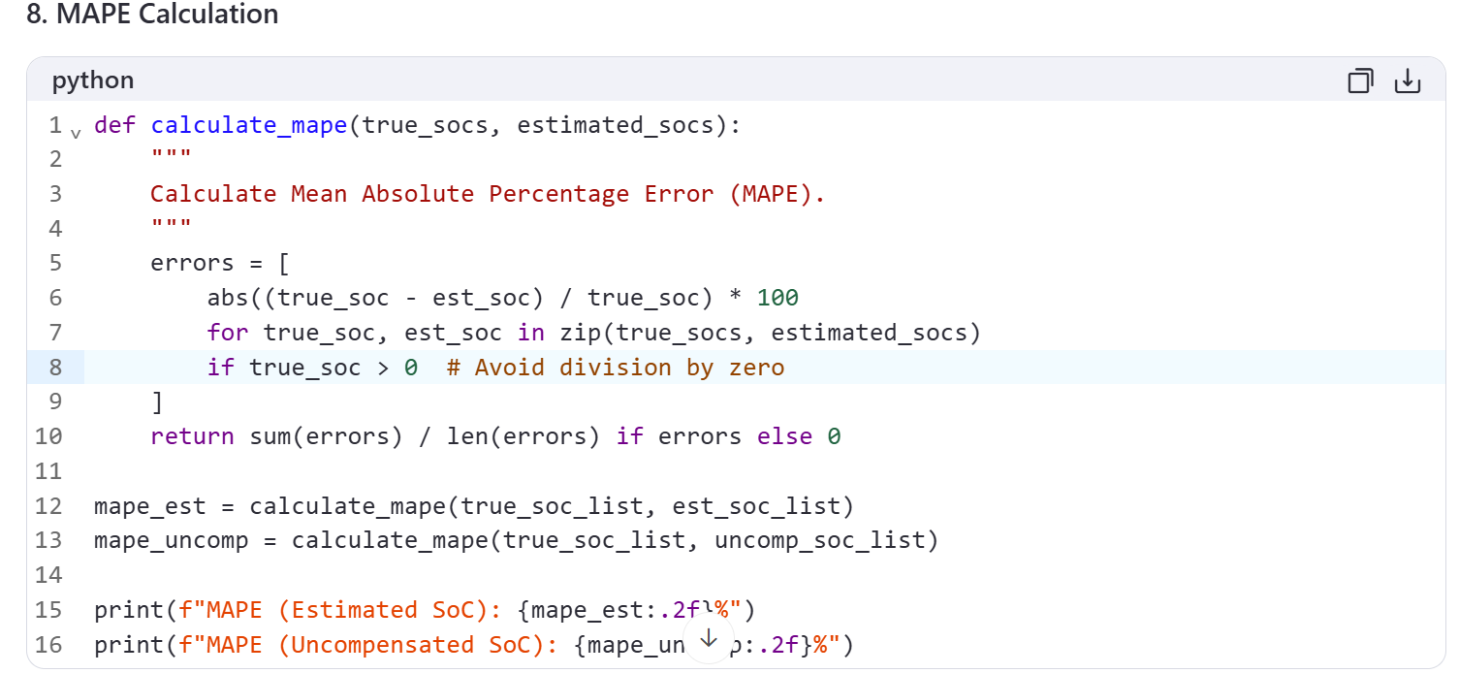

Slide 49
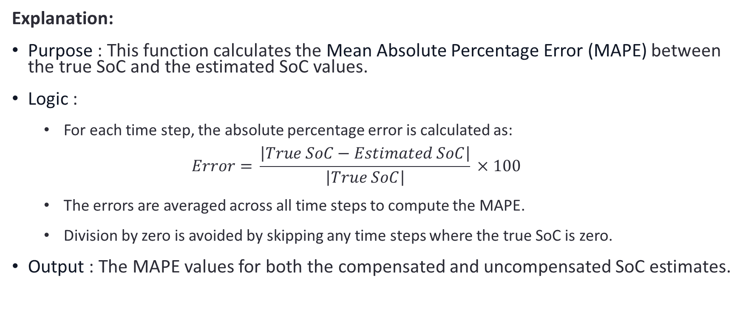
Explanation:
Purpose : This function calculates the Mean Absolute Percentage Error (MAPE) between the true SoC and the estimated SoC values.
Logic :
For each time step, the absolute percentage error is calculated as:
$$Error=​\frac{\left|True SoC−Estimated SoC\right|}{\left|True SoC\right|}​​×100$$
The errors are averaged across all time steps to compute the MAPE.
Division by zero is avoided by skipping any time steps where the true SoC is zero.
Output : The MAPE values for both the compensated and uncompensated SoC estimates.

Slide 50
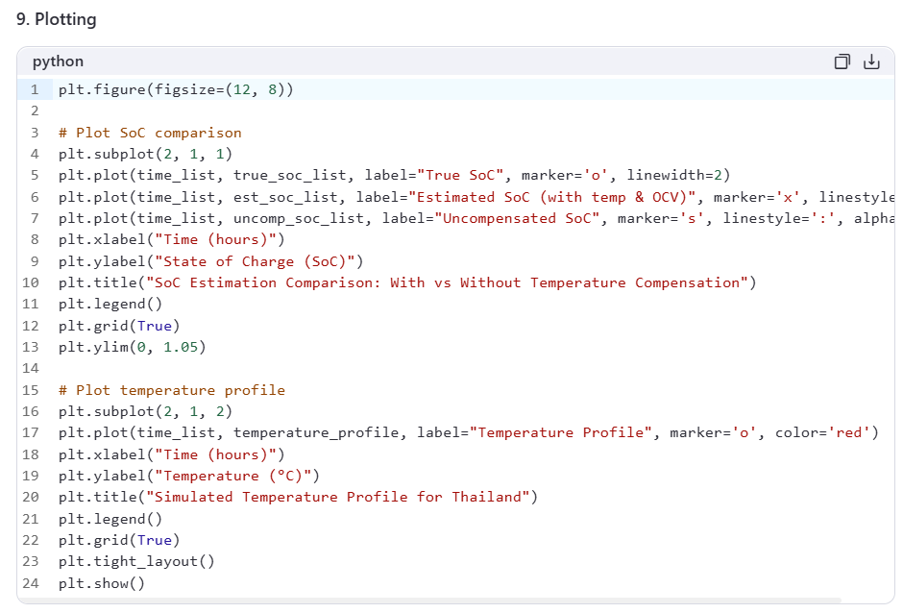

Slide 51
Explanation:
First Subplot :
Compares the true SoC, estimated SoC (with temperature compensation and recalibration), and uncompensated SoC over time.
Second Subplot :
Shows the simulated temperature profile over time, reflecting the realistic high-temperature conditions of Thailand.

